Slide 1

CSD Pool Membership Meeting
Welcome to the 39th Annual
September 16, 2026
csdpool.org

Slide 2
Meeting Agenda
39th Annual CSD Pool Membership Meeting
3:16 p.m. Introduction of Board, Staff, & Pool Partners
3:17 p.m. President’s Opening Statement
3:25 p.m. Confirm Quorum by Attendance and Proxy
3:26 p.m. Approval of 2025 Annual Membership Meeting minuin….. Minutes (Motion)
3:27 p.m. Member Vote on IGA Amendment #2026-1
3:28 p.m. Member Vote on IGA Amendment #2026-2
3:29 p.m. 2025 Yearend Financial Audit Report (Motion)
  Allison Slife, CliftonLarsonAllen, LLP
3:35 p.m. Keynote Address – Beyond Compliance
Brad Johnson, CSP, Parker Water
4:15 p.m. Midyear Review and Market Update
  Joseph DePaepe, Pool Administration, Executive Vice President
4:30 p.m. What to Expect on Your 2027 Renewals
  Renewal Process: Ana Holdren, P&L Operations Director, VP
  Property and Liability Update: Ana Holdren, P&L Operations Director, VP
  Workers’ Compensation Update: Jenniffer J. Alvarado, Deputy Pool Administrator, SVP
4:40 p.m. Final Business
  Questions from Membership
4:45 p.m. Adjourn (Motion)
  Drawing for Door Prizes (must be present to win)
csdpool.org

Slide 3
Call to Order
James Heckman
President, Colorado Special Districts Property and Liability Pool
Representative, Fountain Sanitation District
csdpool.org

Slide 4
Board of Directors
39th Annual CSD Pool Membership Meeting
James Heckman / President
FOUNTAIN SANITATION DISTRICT
Stan Gengler
ESTES VALLEY RECREATION AND PARK DISTRICT
Yvonne Fischbach / Vice President
HYLAND HILLS PARK AND RECREATION DISTRICT
Bill Simmons
BEAVER CREEK METROPOLITAN DISTRICT
Sander Blackburn / Secretary & Comptroller
NORTHERN COLORADO WATER CONSERVANCY DISTRICT
Brad White
GRAND FIRE PROTECTION DISTRICT NO. 1
Sherri Baca
PUEBLO CITY-COUNTY LIBRARY DISTRICT
Lorraine Haywood / Emeritus Board Member
Our SDA Partners
James Borland
FORT COLLINS / LOVELAND WATER DISTRICT
Ann Terry / Ex-Officio Board Member
SPECIAL DISTRICT ASSOCIATION OF COLORADO
Amelia Deleon
MILE HIGH FLOOD DISTRICT
Meredith Quarles / Pool Liaison
SPECIAL DISTRICT ASSOCIATION OF COLORADO
csdpool.org

Slide 5
Staff
39th Annual CSD Pool Membership Meeting
McGRIFF, A MARSH & MCLENNAN LLC COMPANY
Joe DePaepe
Pool Administrator
Kyle Brown
Sr. Safety Consultant
Michael Hawkins
Sr. Workers’ Compensation Claims Examiner
Jenniffer J. Alvarado
Deputy Pool Administrator & Workers’ Comp.
Brennan Mendus
Safety Consultant
Kimberly Pekar
Claims Representative
Ana Holdren
Property & Liability Operations Director
Hunter Freeman
Safety Consultant
Jason Bock
WC Claims Examiner
Paula Lowder
Claims Advocacy Manager
Ana Stewart
Claims Associate
SEDGWICK
Alex Terlecky
Communications Manager
Holly Young
Client Service Director
Shane Cornell
WC Claims Adjuster
Makenzie Kellar
Communications Specialist
Kevin Small
Property & Liability Team Lead
Debbie Misiak
Liability Litigation Consultant
Paige Wharton
Communications Coordinator
Jessica Edwards
Workers’ Compensation Team Lead
csdpool.org

Slide 6
Opening Statement
James Heckman
President, Colorado Special Districts Property and Liability Pool
Representative, Fountain Sanitation District
csdpool.org

Slide 7
Official Business
39th Annual CSD Pool Membership Meeting
Confirmation of Quorum
Motion to Approve 2025 Annual Membership Meeting Minutes
Member Vote on Proposed Pool IGA Amendment #2026-1
  See Sample Ballot in folder for reference only
Member Vote on Proposed Pool IGA Amendment #2026-2
  See Sample Ballot in folder for reference only
csdpool.org

Slide 8
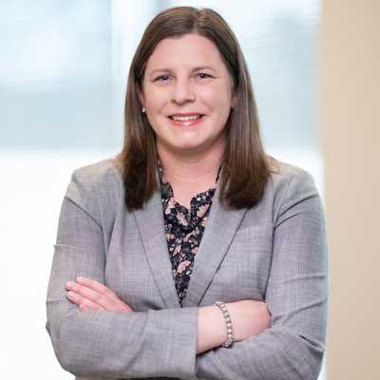
Financial Statement
39th Annual CSD Pool Membership Meeting
Refer to 2025 CSD Pool Annual Report Handout
Respond to Member Questions
Motion to Approve 2025 CSD Pool Annual Report
Allison Slife / Auditor
CliftonLarsonAllen, LLP
csdpool.org

Slide 9


Slide 10
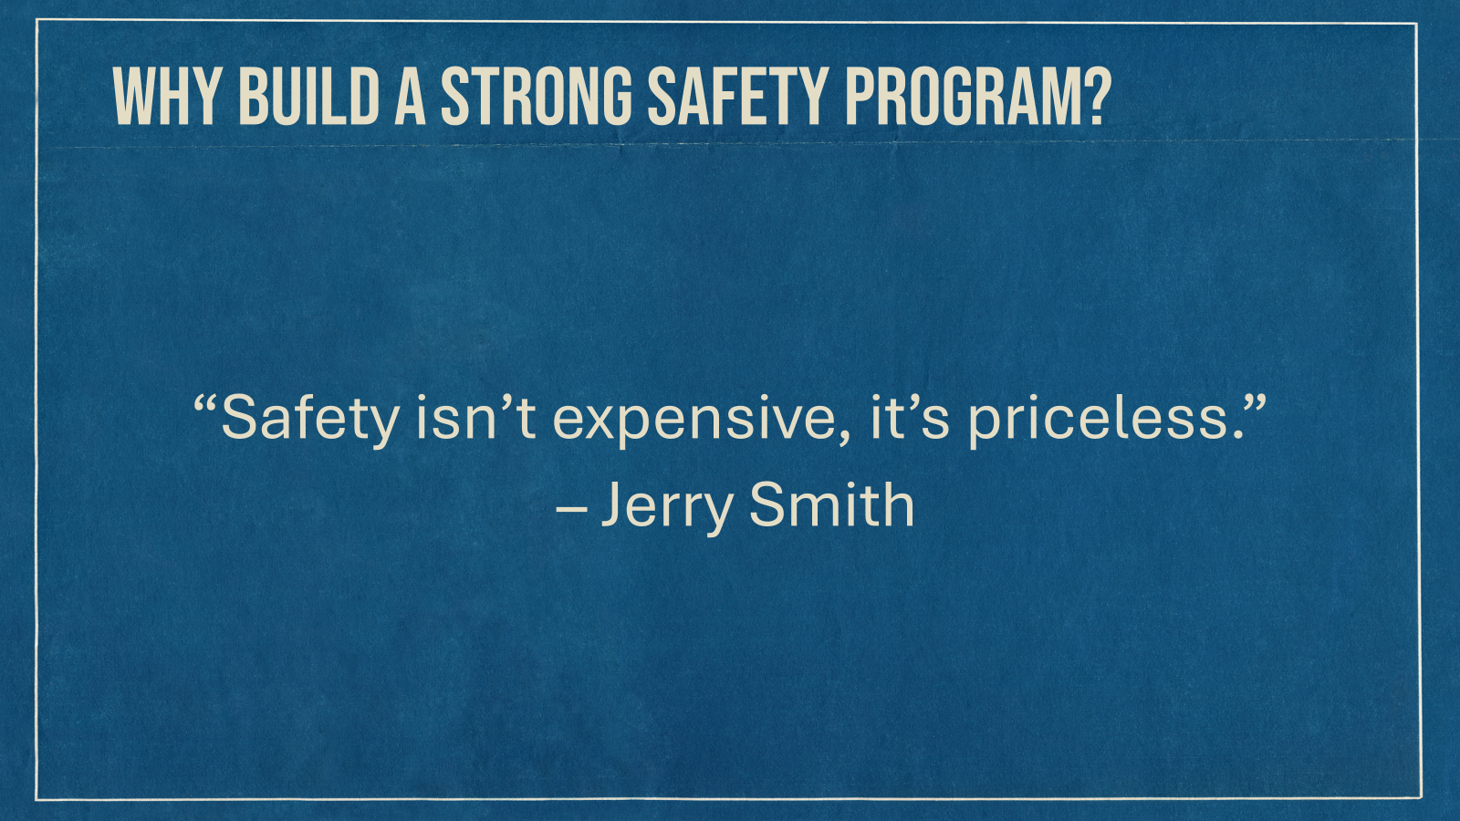

Slide 11

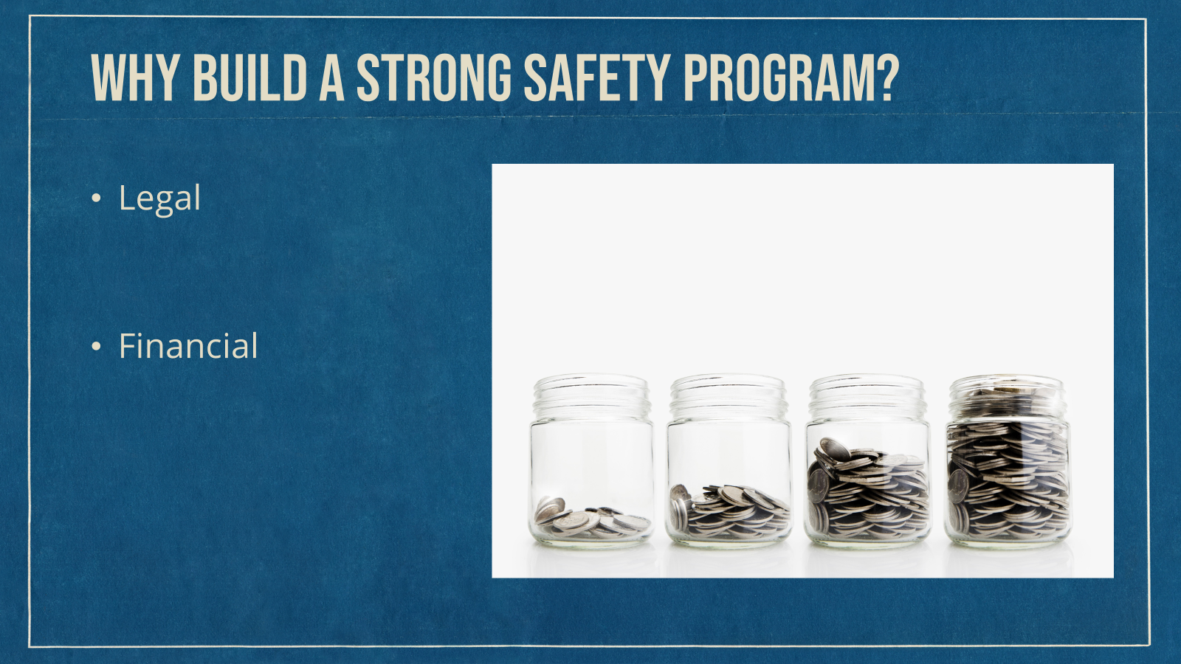


Slide 12


Slide 13
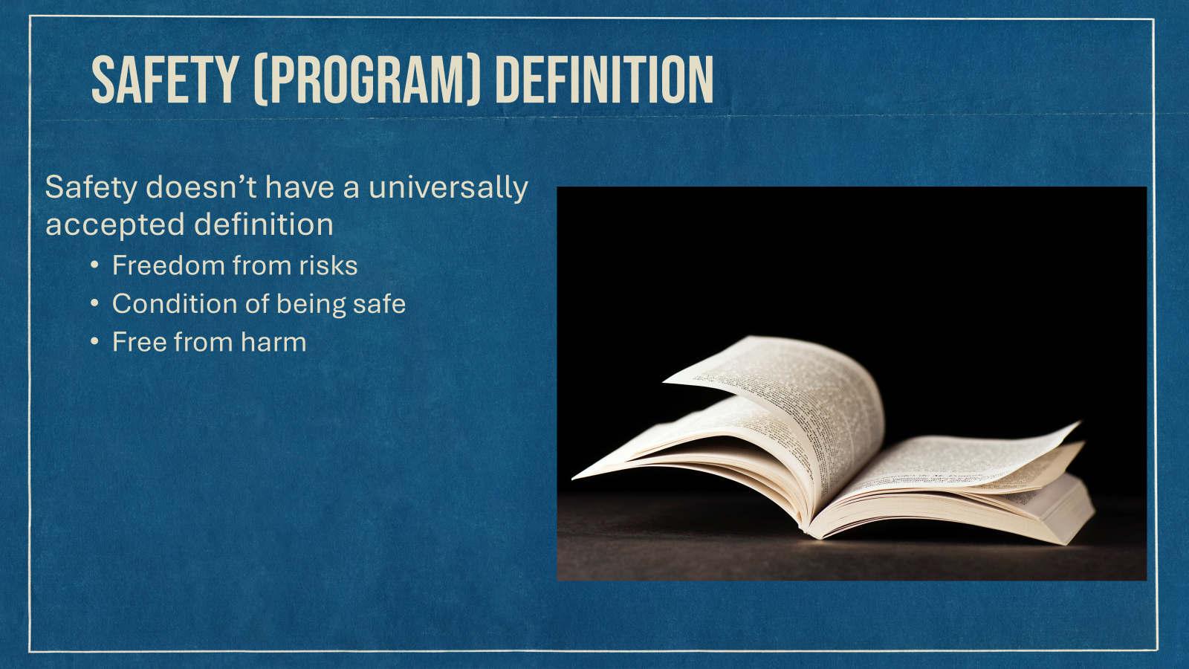

Slide 14


Slide 15
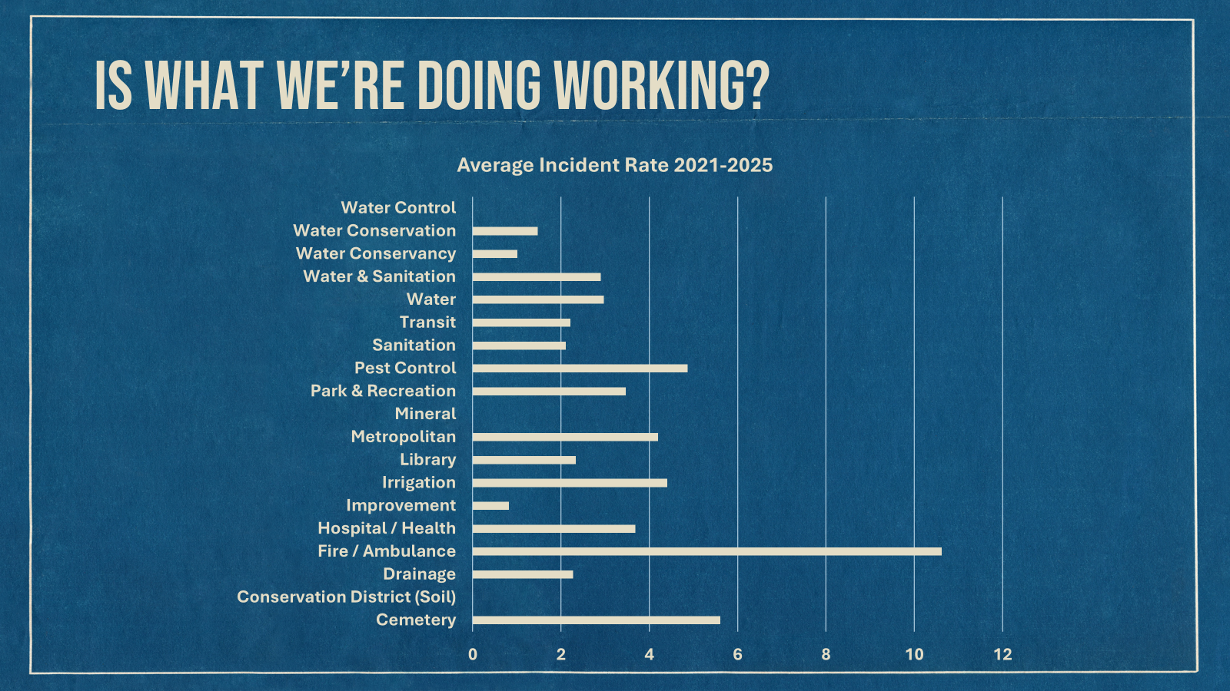

Slide 16
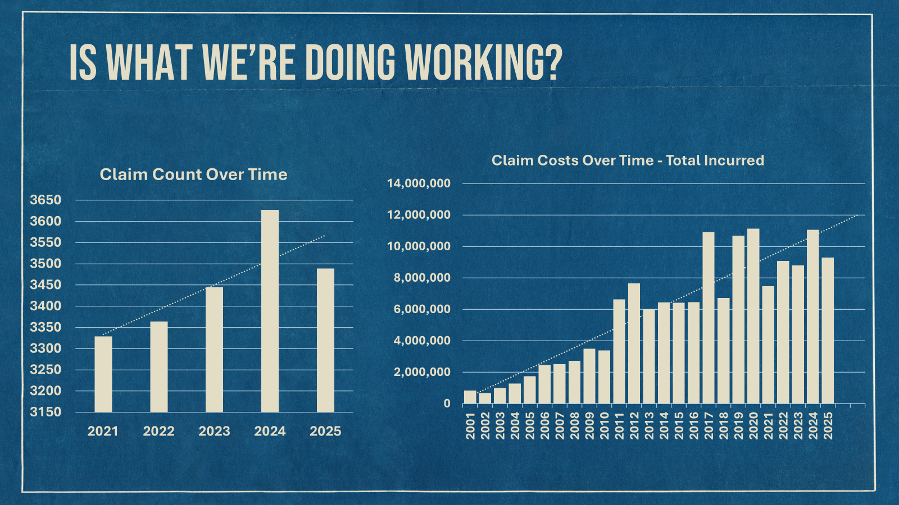

Slide 17


Slide 18
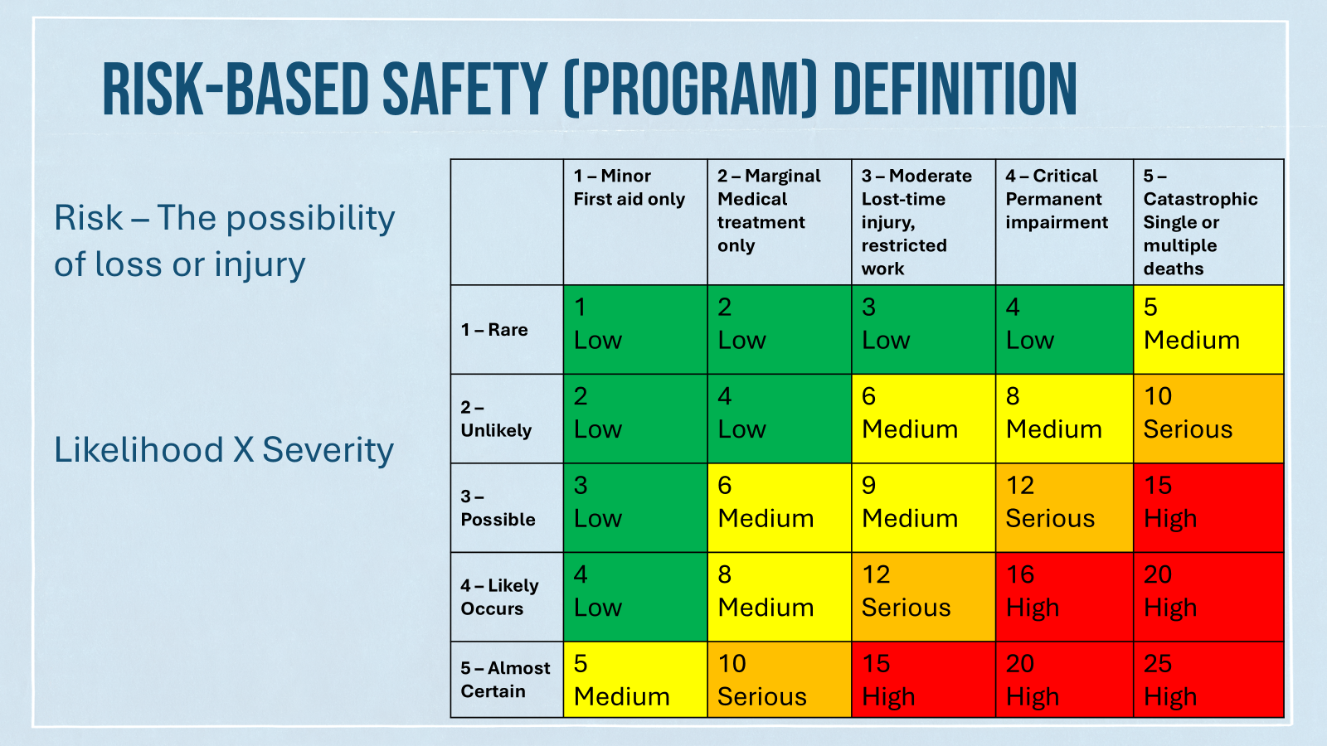

Slide 19
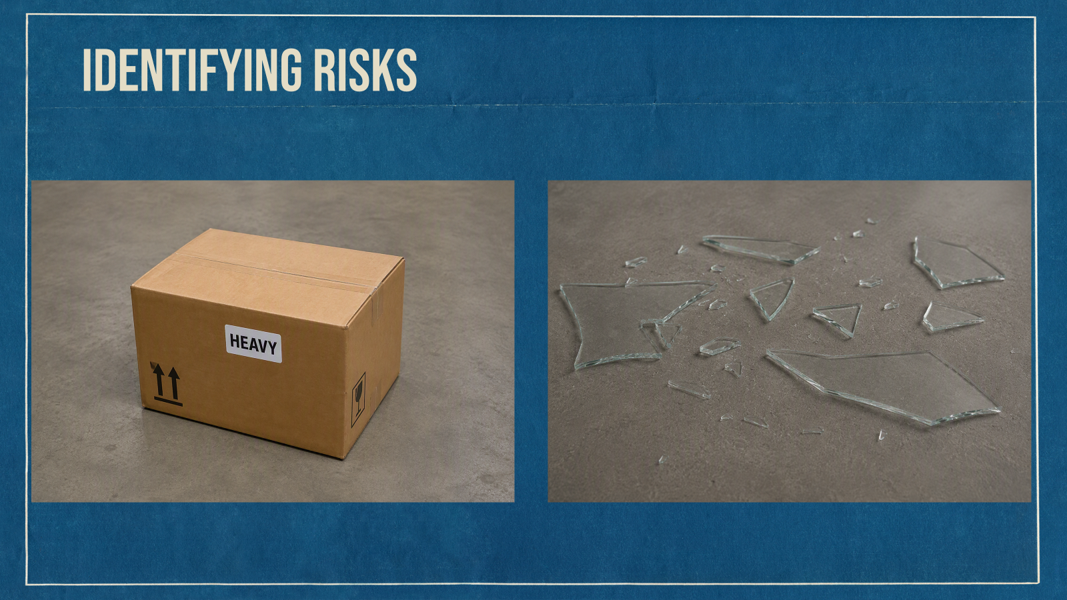


Slide 20



Slide 21
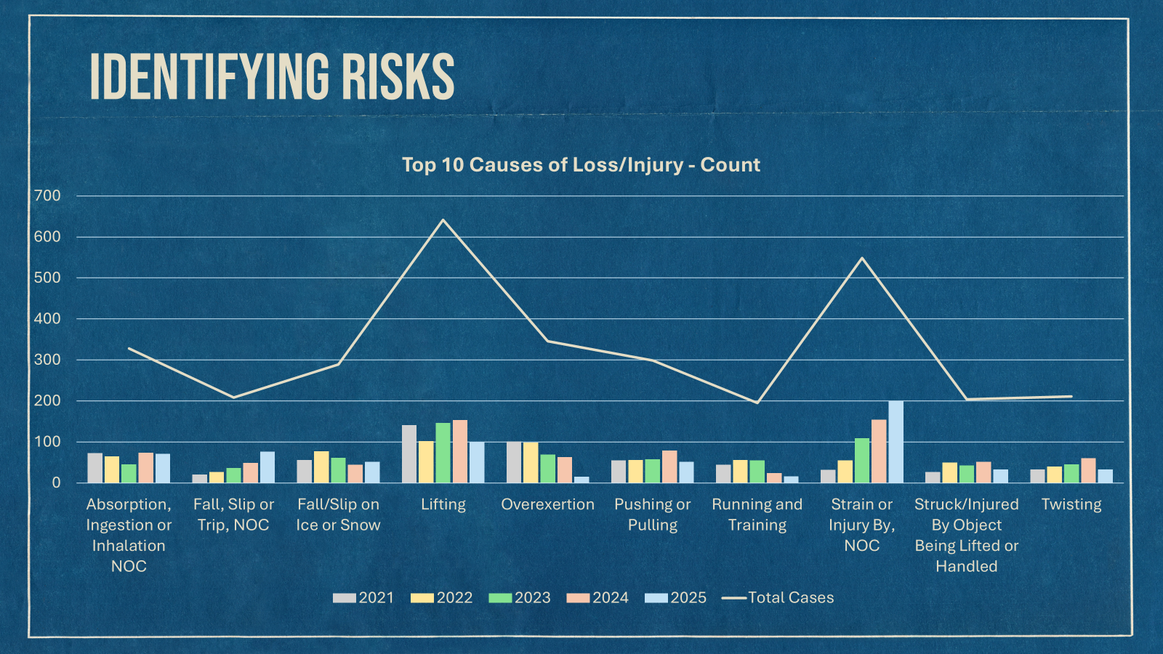

Slide 22
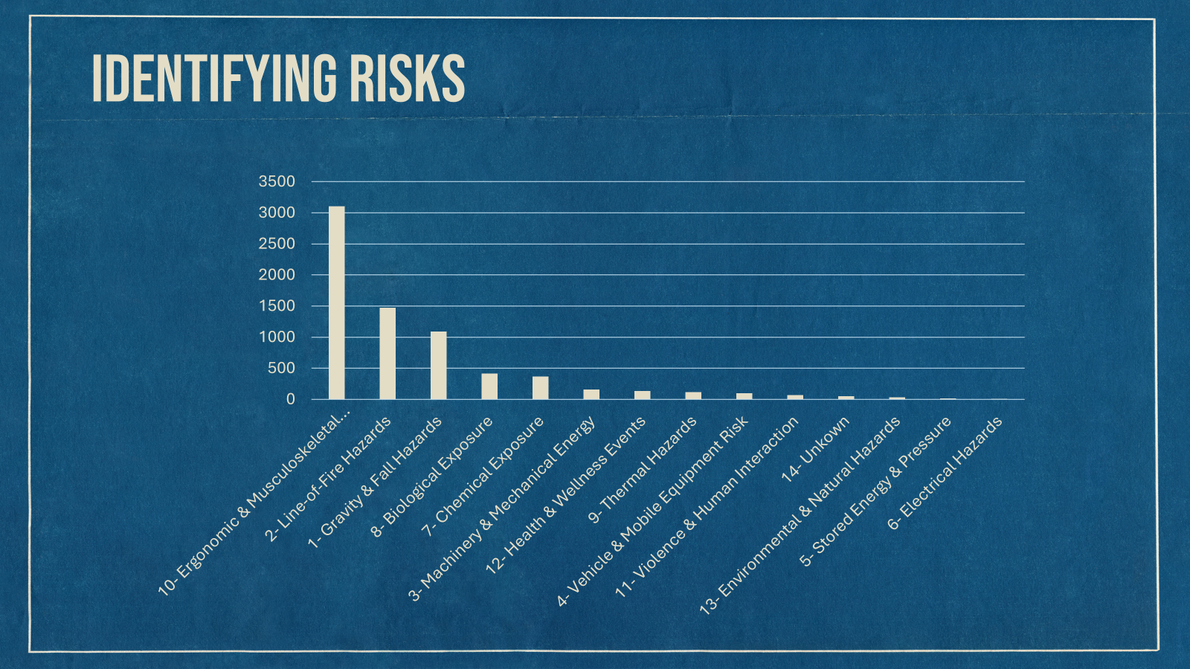

Slide 23
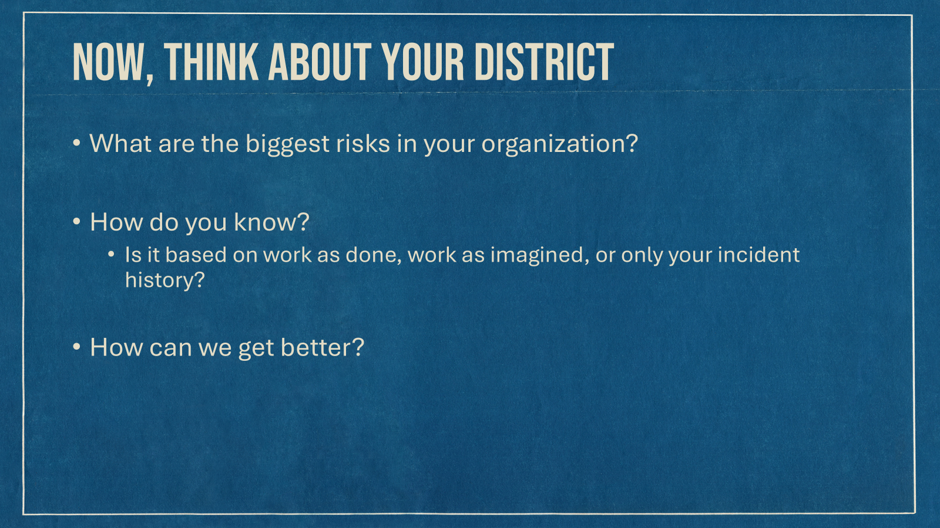

Slide 24




Slide 25

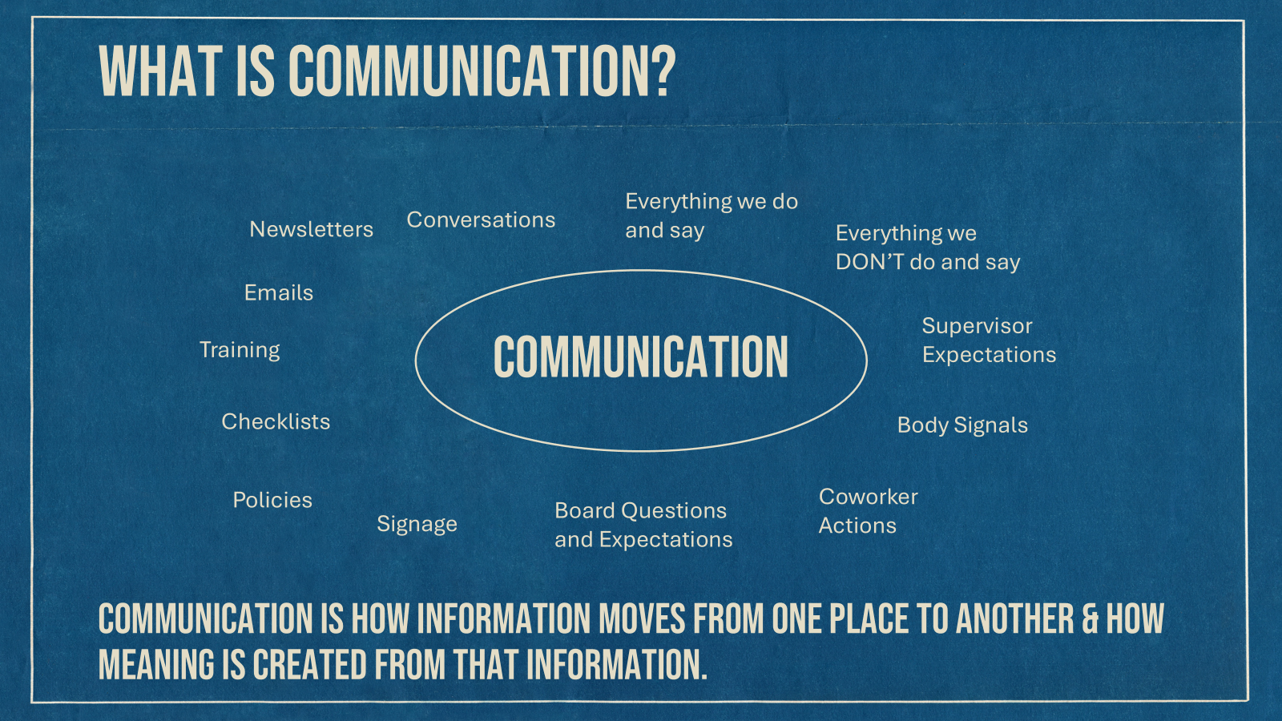



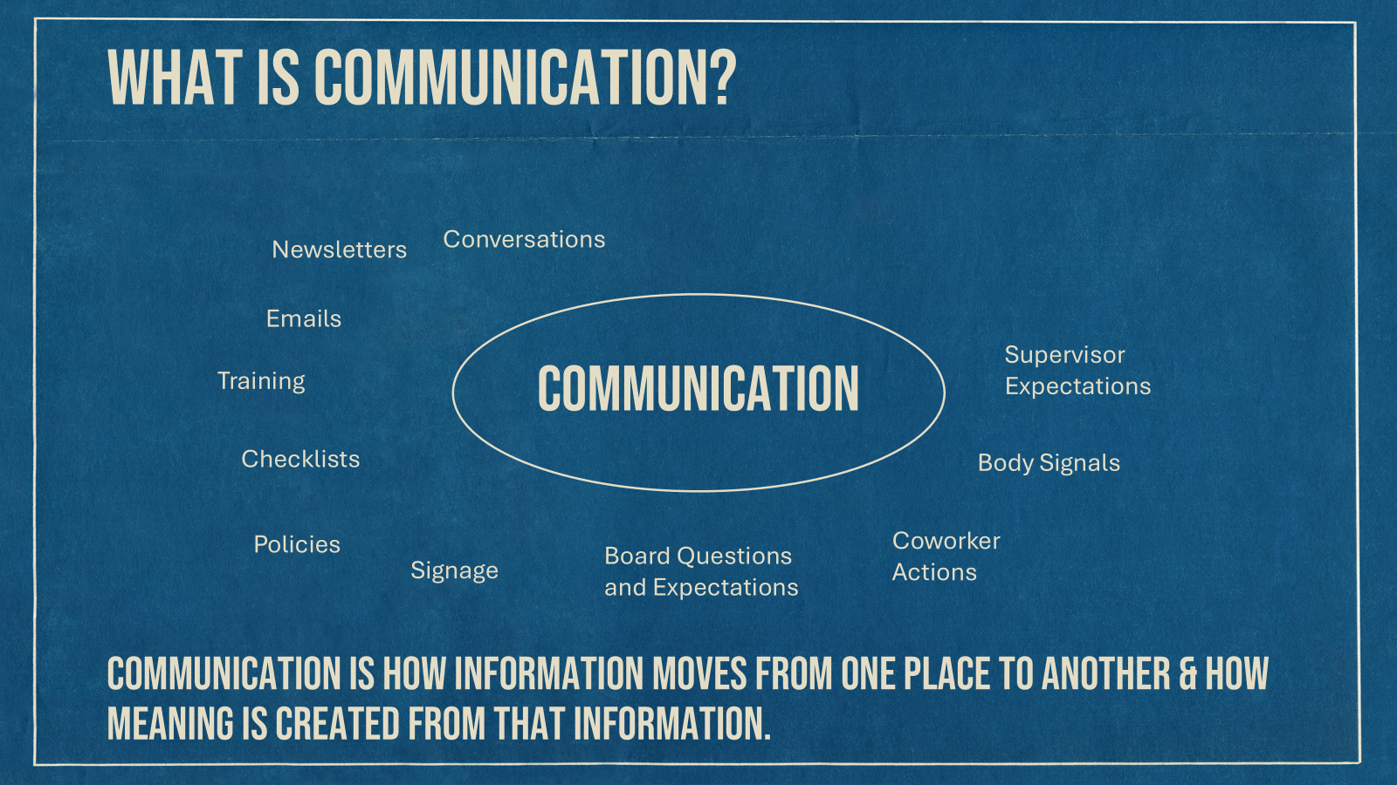


Slide 26
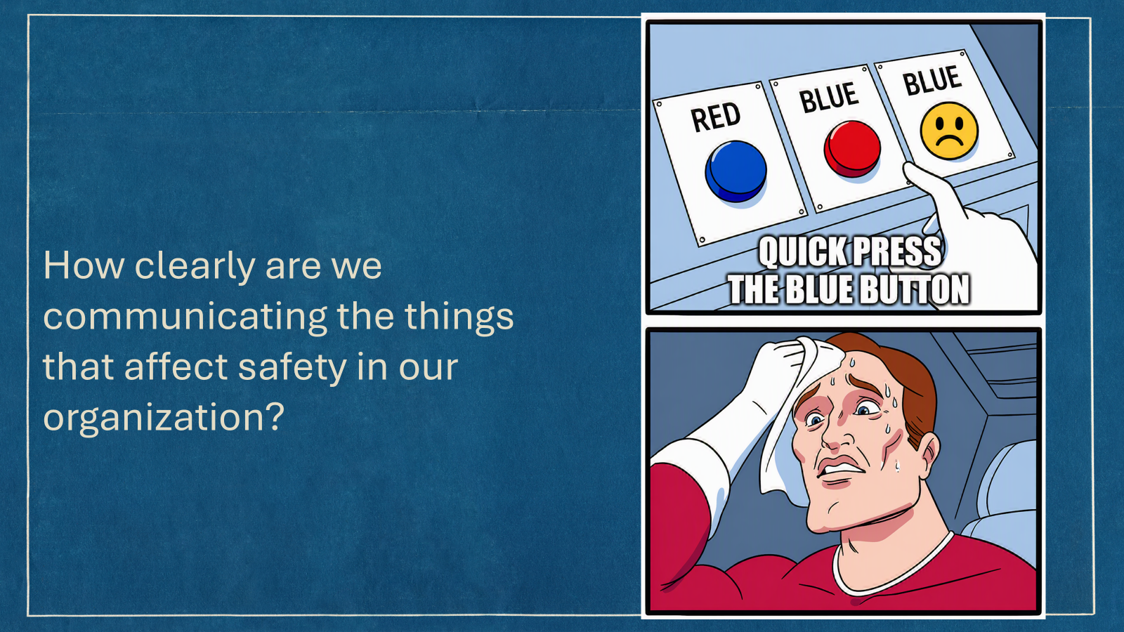


Slide 27



Slide 28
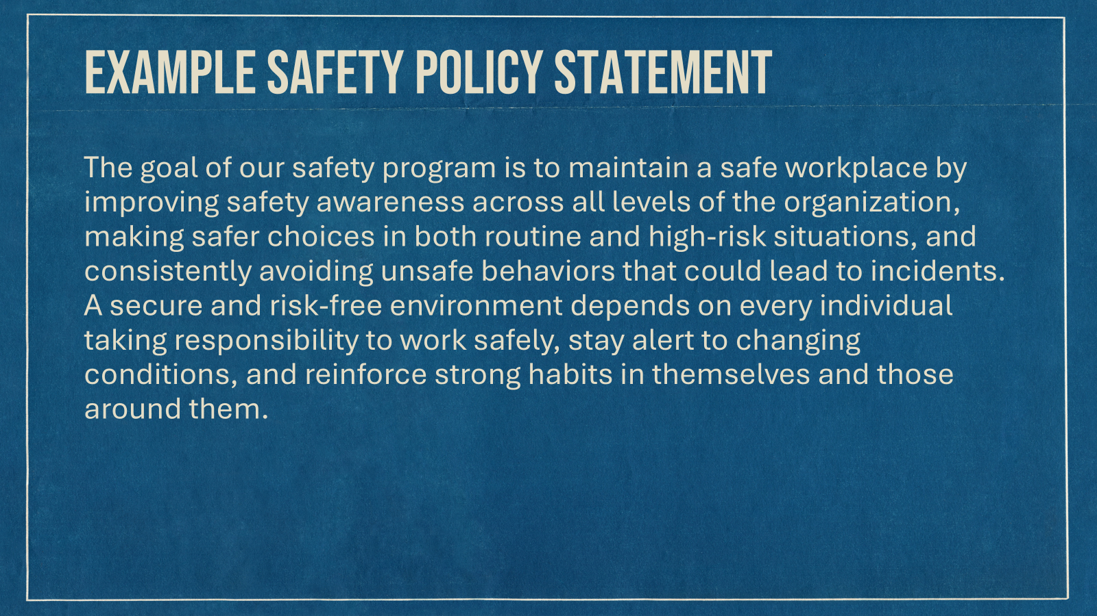

Slide 29
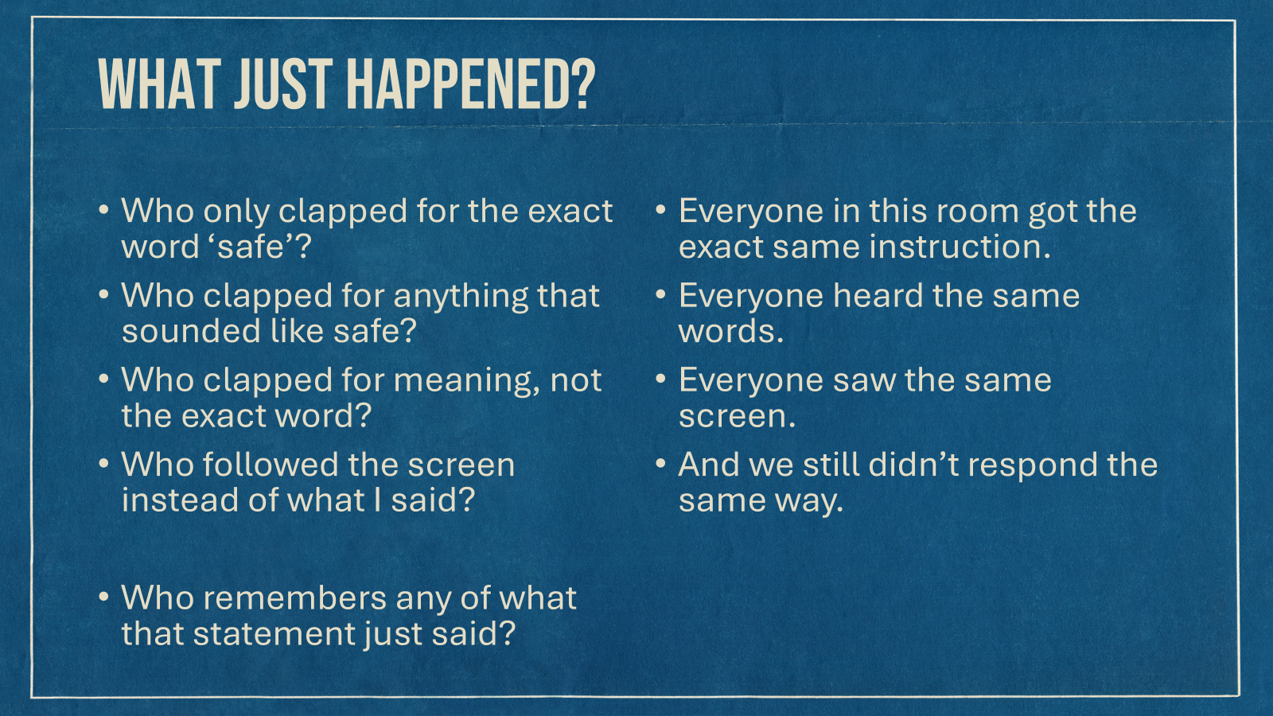


Slide 30
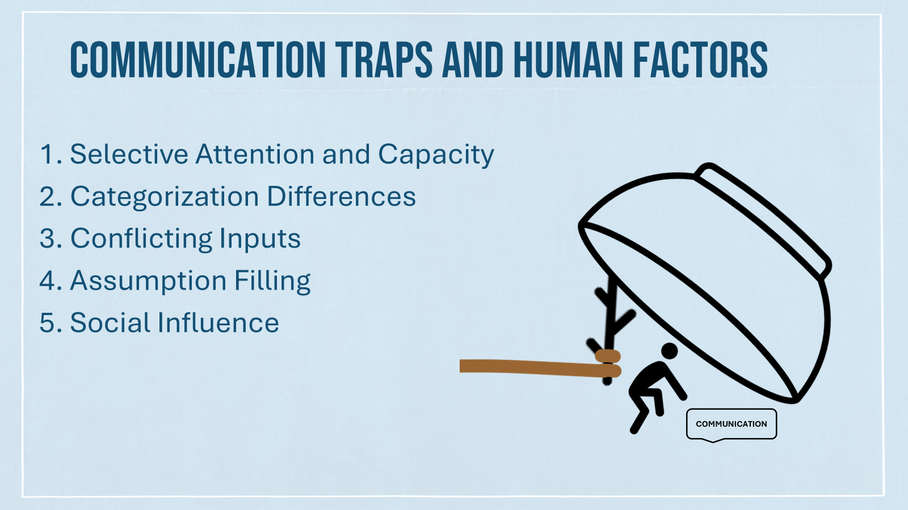

Slide 31


Slide 32
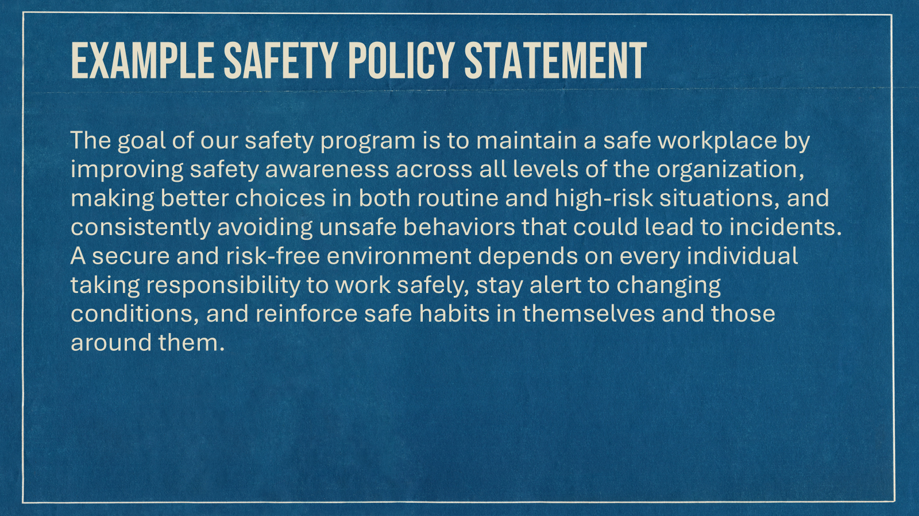

Slide 33
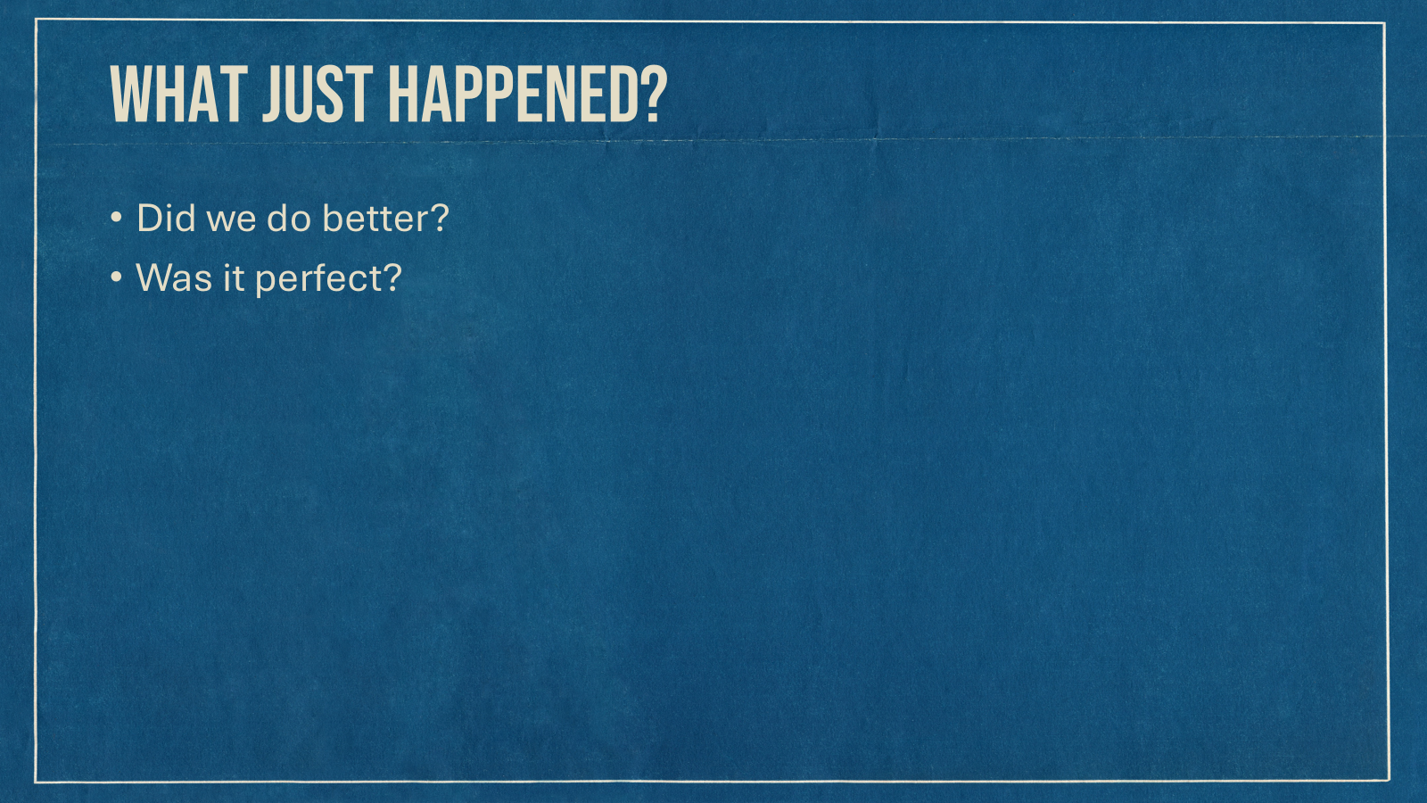

Slide 34


Slide 35


Slide 36
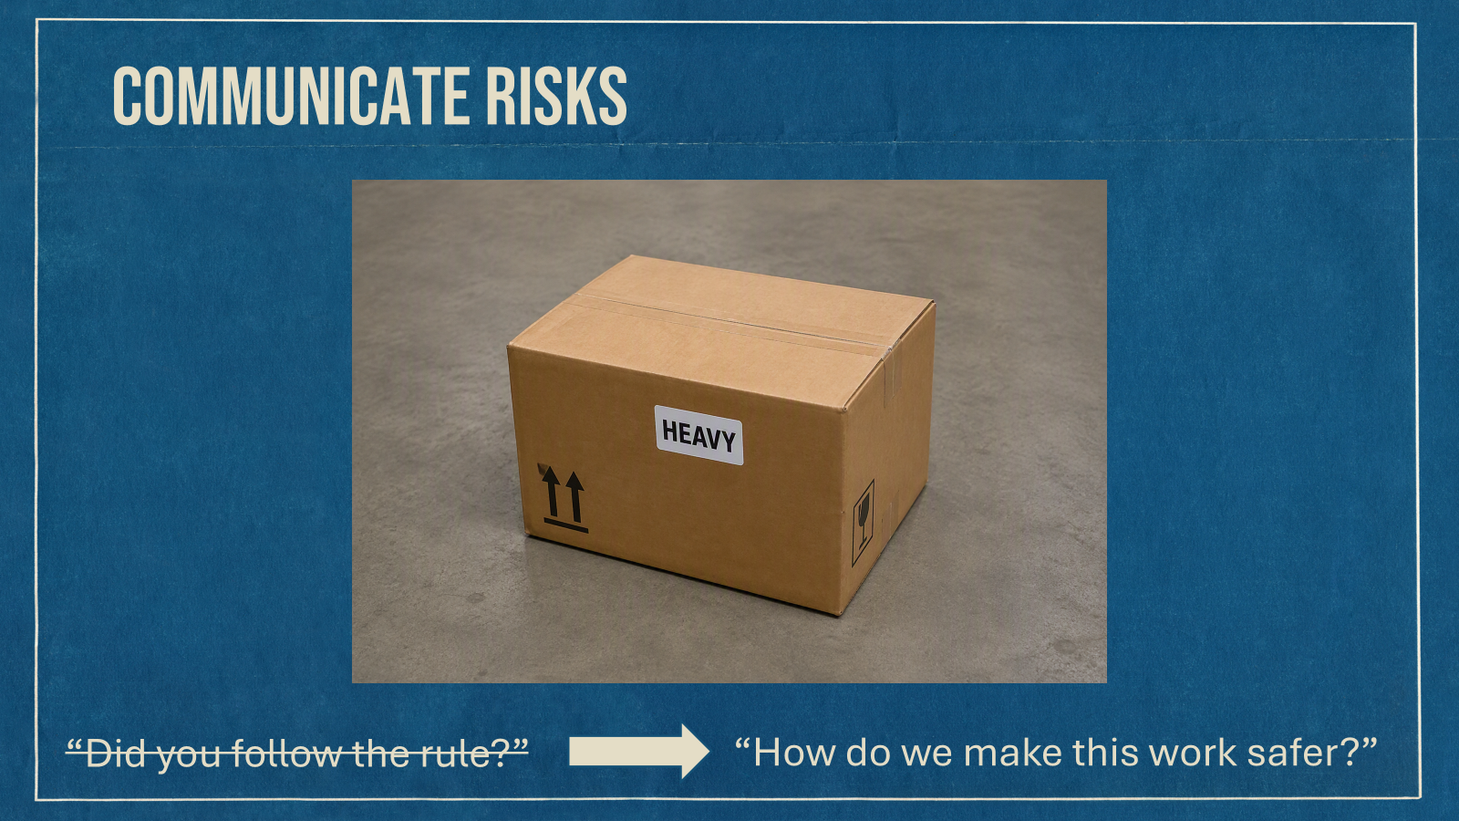

Slide 37


Slide 38
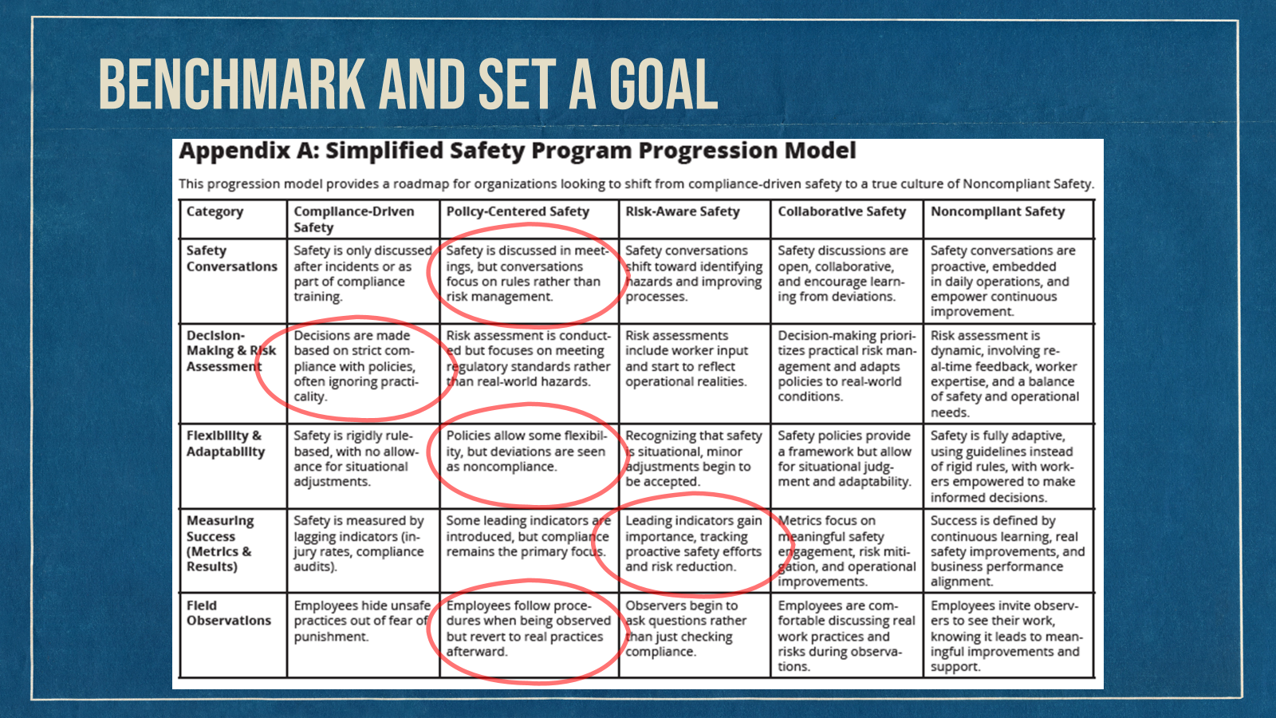

Slide 39
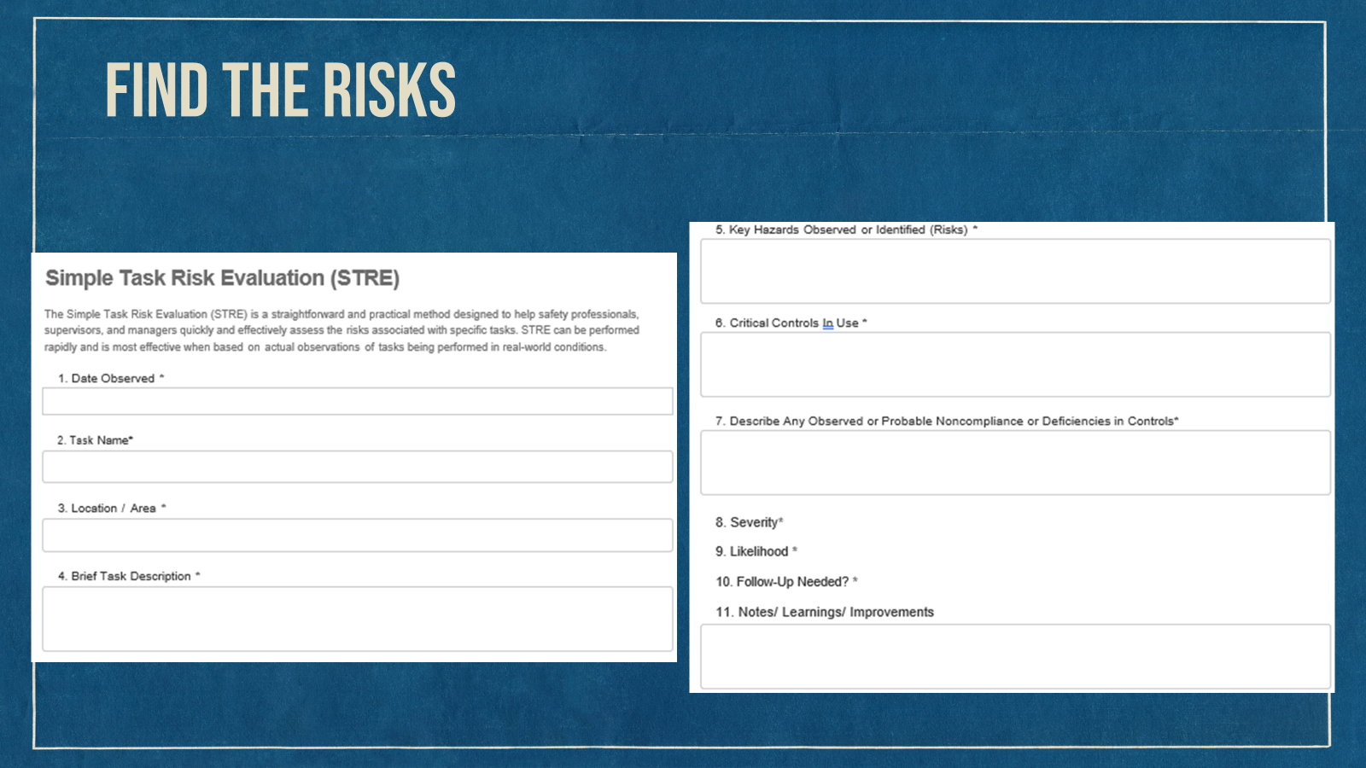

Slide 40
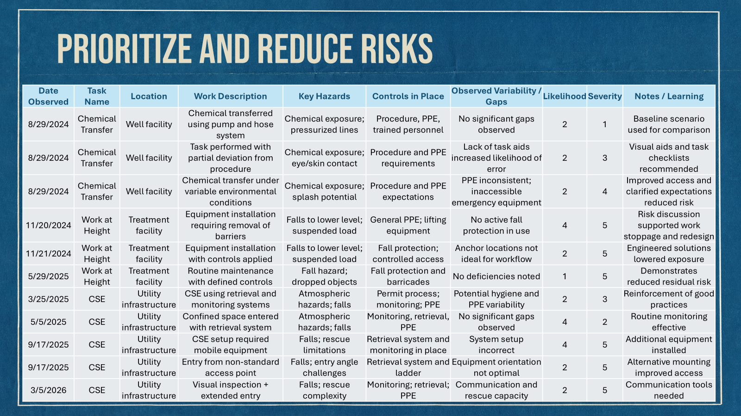

Slide 41
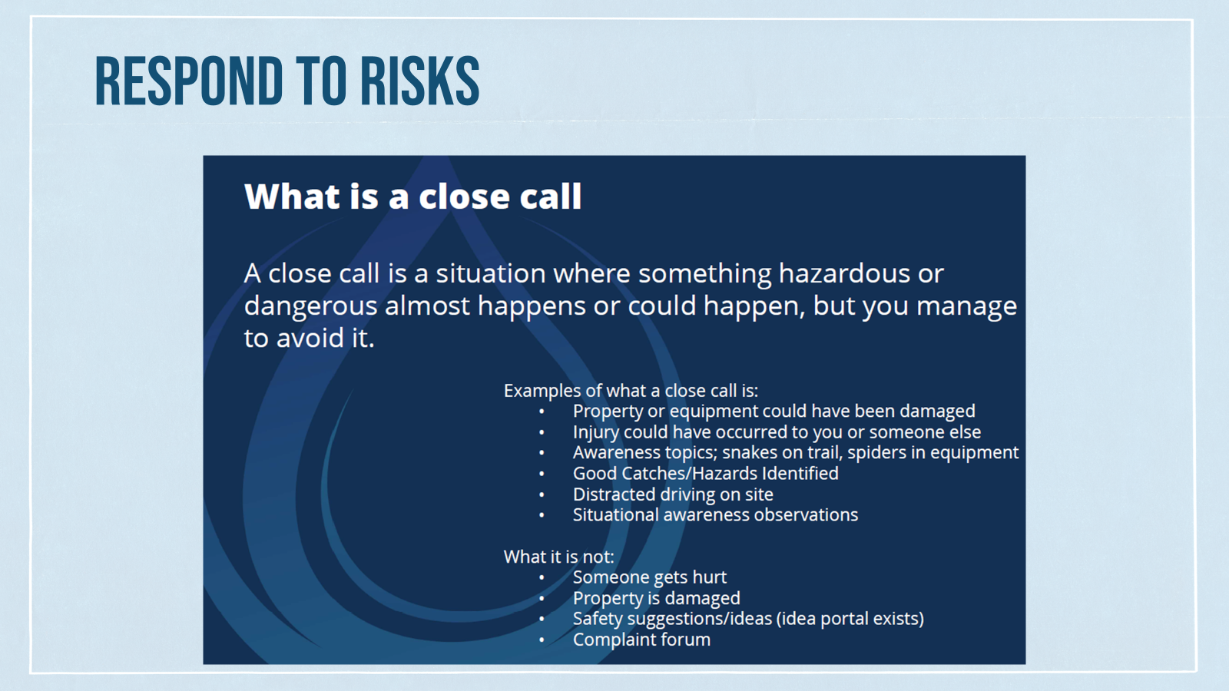

Slide 42


Slide 43


Slide 44
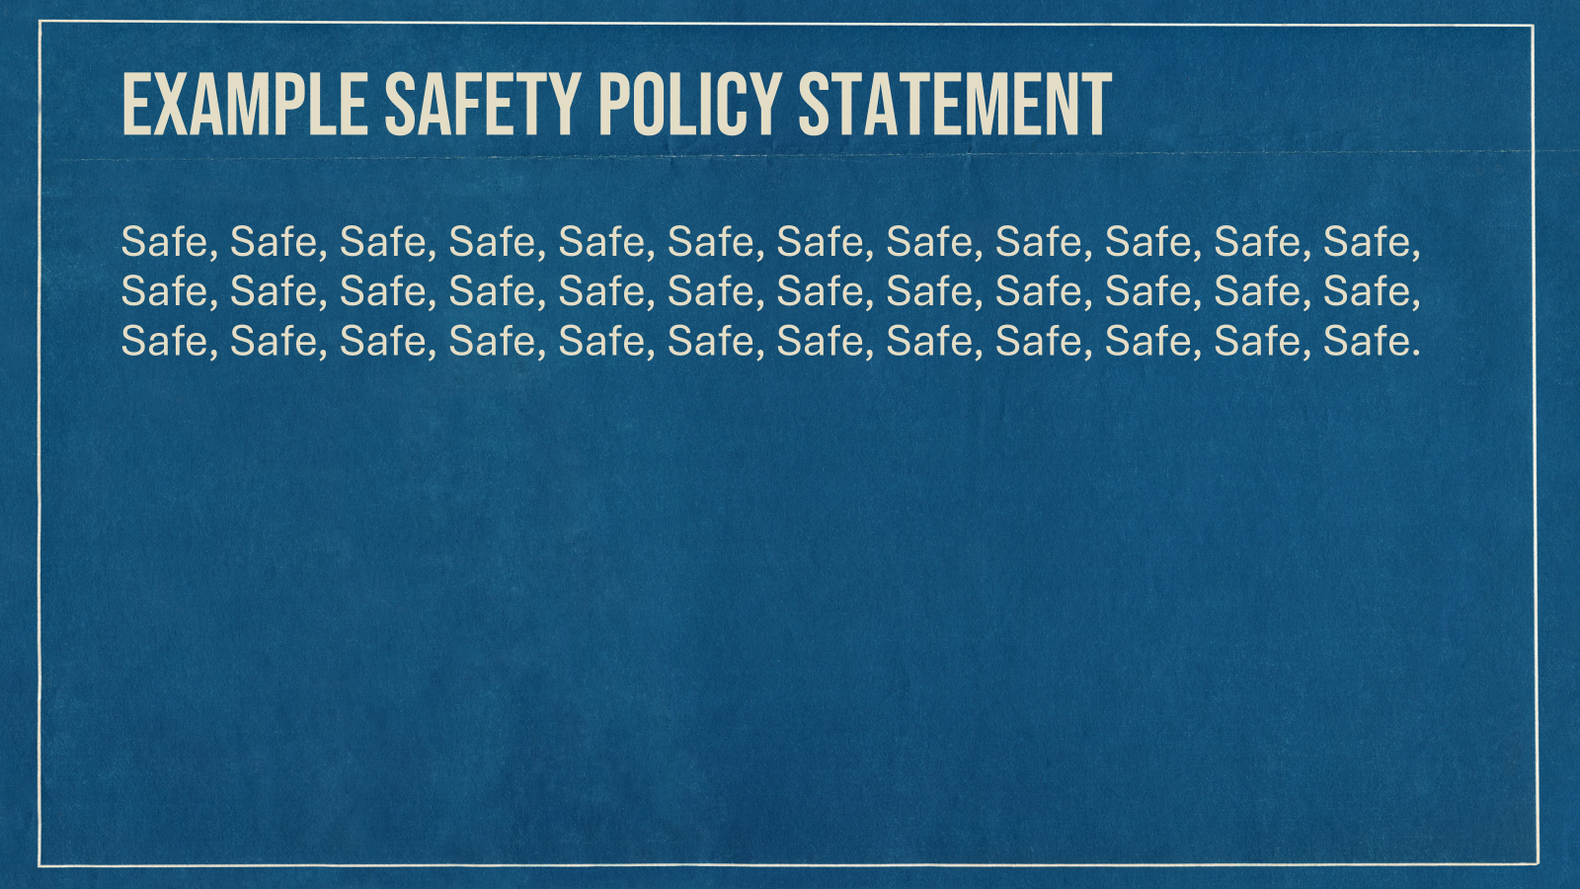

Slide 45


Slide 46
Mid-Year Review & Insurance Market Update
39th Annual CSD Pool Membership Meeting
2026 YTD – Approx. 2,400 members and Gross Contribution $63 MM (13% increase)
Positive YTD Net Income of $4 MM – Favorable Property & Liability losses with positive Workers’ Compensation results due to fewer Indemnity claims
  Fewer high dollar indemnity claims contributing to better WC performance
  Continued rate stabilization favors members with limited rate increases per Board rate stabilization policy
  Both programs continuing positive performance
Financial Strength
  19 Financial ratios available; strain on financial ratios moderated due to achieving more equitable rates
  Demotech Rating of the Pool continues as “AAA Unsurpassed”
csdpool.org

Slide 47
Mid-Year Review & Insurance Market Update (Cont.)
39th Annual CSD Pool Membership Meeting
Insurance market update shows property down, liability stable, auto up and cyber mixed, with more moderate price changes across most lines
Competition lacks the risk management programs and services the Pool offers
A new cost containment program called the "Safety Program Benefit Award" is offering additional contribution credits
10% of our members have been with the Pool for at least seven years – reaching this threshold results in contribution credits for member loyalty
The CSD Pool is YOUR RISK MANAGEMENT PARTNER, bringing you the resources you need to ensure your fiduciary responsibility to protect district employees and assets is achieved
Questions?
csdpool.org

Slide 48
Renewal Process
39th Annual CSD Pool Membership Meeting
Renewal invitations for the Property & Liability (P&L) will be emailed this month. You will receive general information on rates, coverage changes, and a link to the CSD Pool website.
We ask all districts to complete their renewal updates online by end of day, October 30.
We will close the renewal website November 1. Districts who have not submitted their updates before this deadline will receive a 10% surcharge against their contribution and coverage will be automatically renewed.
csdpool.org

Slide 49
Renewal Process (Cont.)
39th Annual CSD Pool Membership Meeting
We review renewal submissions shortly after they are submitted. If any additional information or documents are needed, we’ll send an email with that request. We will begin issuing renewal documents October 1 and they will be processed in the order the complete submission was received. The sooner your updates are submitted to the CSD Pool, the sooner we can return your 2027 coverage documents to you!
Workers’ Compensation and Property & Liability renewals are processed and issued separately.
Remember, SDA Membership is required for you to be a member of the CSD Pool.
Questions?
csdpool.org

Slide 50
Property Renewal
39th Annual CSD Pool Membership Meeting
Annually, an evaluation is performed to determine what areas, if any, need to be changed for the next program year. The program can be left as written or there can be rate adjustments and/or increased deductibles.
Rate increases are needed again in 2027 to fund higher retentions imposed by reinsurers; in other words, build savings to have sufficient funds to pay future claims. Depending on the experience of each district type, rate increases will be:
Property: Ranging from 1% to 4% | Auto Physical Damage (APD): Ranging from 1% to 6%
Equipment Breakdown: Ranging from 1% to 2% | Crime: All district types will see a 1% increase
The CSD Pool implemented a hail surcharge under Property and Auto Physical Damage after the large 2018 hail losses. Rather than adding a large surcharge, it was decided that incremental increases over a 10-year period be added to achieve rate stabilization and help avoid rate spikes when bad weather occurs. As we are in the last year of that incremental period, we will increase the hail surcharge by another 7% in the hail prone counties.
csdpool.org

Slide 51
Property Renewal (Cont.)
39th Annual CSD Pool Membership Meeting
The Wind/Hail Deductible endorsement will continue to apply. For districts that have a total value of real property and outdoor property below $25M, it increases the deductible to 2% of the covered damaged property and applicable business income at the time loss occurs, subject to a $5,000 minimum and $50,000 maximum per occurrence, unless a higher deductible is scheduled at the damaged location. For districts having total values excess of $25M, the terms are the same except the maximum per occurrence deductible is $75,000, unless a higher deductible is scheduled at the damaged location. This deductible needs to be budgeted and funded by the district.
Alternatively, for an additional contribution, a deductible buyback endorsement is available which will reduce the Wind/Hail deductible to $5,000 per occurrence. The endorsement is available for purchase until May 1 annually.
The flood rate for properties located in high-risk Zone A will increase by 5%.
csdpool.org

Slide 52
Property Renewal (Cont.)
39th Annual CSD Pool Membership Meeting
  Building values will trend up between 2.5% and 3% based on the construction type. Outdoor property (NOC) will trend up 2.9% while contents and inland marine scheduled items will increase by 6.9%.
  Automobile values will be trended down by 2.5% for depreciation. Note, that this only applies to vehicles valued at Actual Cash Value. For those valued at Replacement Cost (which includes emergency vehicles), we encourage members to review and update the vehicle value to ensure it is sufficient to replace the vehicle in the event of a total loss due to these increasing costs.
    Additional rate adjustments or increased deductibles are possible for some individual members based on their own experience rating (losses compared to contributions).
csdpool.org

Slide 53
Property Renewal (Cont.)
39th Annual CSD Pool Membership Meeting
Members who do not participate or are not active in the SambaSafety driver monitoring program, will receive a 5% surcharge on their Auto Physical Damage contribution. We consider a member to be active when they have logged into the system at least annually to review and update employee list and driver information.
Coverage Form Changes:
  The Property Coverage documents will be updated to extend Business Income and Extra Expense coverage in the event of a Public Safety Power Supply (PSPS) outage to a covered Premises subject to a 24-hour waiting period.
  No updates are being made to the Auto Physical Damage Coverage Document.
Questions?
csdpool.org

Slide 54
Liability Renewal
39th Annual CSD Pool Membership Meeting
As previously mentioned, an evaluation is performed to determine what areas, if any, need to be changed for the next program year. The program can be left as written or there can be rate adjustments and/or increased deductibles.
Rate increases are needed again in 2027 to fund for increased retentions. Depending on the experience of each district type, rate increases will be:
  Members who don’t participate or are not active in the SambaSafety driver monitoring program will receive a 5% surcharge on their Automobile Liability contribution. A member is active when they have logged into the system at least annually to review and update employee list and driver information.
General Liability, ranging from 3% to 5% | Automobile Liability, Ranging from 3% to 6%
Public Officials Liability, ranging from 3% to 6% | No Fault Water/Sewer, Ranging from 0% to 5%
csdpool.org

Slide 55
Liability Renewal (Cont.)
39th Annual CSD Pool Membership Meeting
  The rate for Volunteer Accident coverage will not change this year, however, the minimum contribution for this coverage line will increase from $50 to $60.
  Additional rate adjustments or increased deductibles are possible for some individual members based on their own experience rating (losses compared to contributions).
Coverage Form Changes:
  The Public Entity Liability Coverage document will be updated to add an exclusion for bodily injury, personal injury, property damage, advertising injury damages arising out of Generative Artificial Intelligence.
  Questions?
csdpool.org

Slide 56
Workers' Compensation Renewal
39th Annual CSD Pool Membership Meeting
Renewal Process and Updates
Board Member Only (BMO) Districts
  No contribution increase: BMOs remain at $450, less applicable discount for 2027.
  Board Members (BM) need to continue to report all duties being performed in addition to any other BM Administrative duties.
  Please always obtain Certificates of Insurance and Independent Contractor Status Forms from all contractors.
  BMO renewal packets were emailed to members or brokers in early-August. Changes must be received by October 16. Payments due January 1. Intent-to-Cancel Notices issued by the end of January for non-payment, as applicable.
  A payment reminder was put in the mail this week, emails reminder will continue being sent out.
csdpool.org

Slide 57
Workers' Compensation Renewal (Cont.)
39th Annual CSD Pool Membership Meeting
Renewal Process and Updates
All Other Districts
  5% to 10% increase on base rates. Review your payroll changes as you budget for 2027. Contribution is rated on payroll.
  Higher discounts available for increased cost containment results.
  Renewal invites were emailed on August 31. Please complete updates by October 16.
  Make sure Payroll Schedule is updated in its entirety based on your 2027 budget.
  Non-responders will receive a 10% increase on payroll starting December 1, thus generating an automatic renewal
  Payments due January 8, 2027 to take advantage of our Early Pay Discount.
  Intent-to-Cancel Notices will be issued by the end of January in the event of non-payment.
csdpool.org

Slide 58
Final Business
39th Annual CSD Pool Membership Meeting
Any other business or questions from the membership?
We have most of our Claim Adjusters from Sedgwick here; they will be at the Pool’s booth; so, please feel free to take the opportunity to meet with those you have worked with.
Move to adjourn meeting.
csdpool.org

Slide 59
Thank You for Attending!
Email questions to info@csdpool.org
Questions? Come see us at our booth!
Prize Drawings Up Next!
You must be present to win.
csdpool.org

