Slide 1

CSD Pool Membership Meeting
Welcome to the 38th Annual
September 17, 2025
csdpool.org

Slide 2
Meeting Agenda
38th Annual CSD Pool Membership Meeting
3:15 p.m. Call to Order
3:16 p.m. Introduction of Board, Staff, & Pool Partners
3:17 p.m. President’s Opening Statement
3:25 p.m. Confirm Quorum by Attendance and Proxy
3:26 p.m. Approval of 2024 Annual Membership Meeting minuin….. Minutes (Motion)
3:27 p.m. 2024 Yearend Financial Audit Report (Motion)
  Allison Slife, CliftonLarsonAllen, LLP
3:35 p.m. Keynote Address – Preparing for Disruption
Kyle Brown, Sr. Risk Control Consultant
4:15 p.m. Midyear Review and Market Update
  Joseph DePaepe, Pool Administration, Executive Vice President
4:30 p.m. What to Expect on Your 2026 Renewals
  Renewal Process: Ana Holdren, P&L Operations Director, VP
  Property and Liability Update: Ana Holdren, P&L Operations Director, VP
  Workers’ Compensation Update: Jenniffer J. Alvarado, Deputy Pool Administrator, SVP
4:40 p.m. Final Business
  Questions from Membership
4:45 p.m. Adjourn (Motion)
  Drawing for Door Prizes (must be present to win)
csdpool.org

Slide 3
Call to Order
James Heckman
President, Colorado Special Districts Property and Liability Pool
Representative, Fountain Sanitation District
csdpool.org

Slide 4
Board of Directors
38th Annual CSD Pool Membership Meeting
James Heckman / President
FOUNTAIN SANITATION DISTRICT
Stan Gengler
ESTES VALLEY RECREATION AND PARK DISTRICT
Yvonne Fischbach / Vice President
HYLAND HILLS PARK AND RECREATION DISTRICT
Bill Simmons
BEAVER CREEK METROPOLITAN DISTRICT
Sander Blackburn / Secretary & Comptroller
NORTHERN COLORADO WATER CONSERVANCY DISTRICT
Lorraine Haywood / Emeritus Board Member
Sherri Baca
PUEBLO CITY-COUNTY LIBRARY DISTRICT
Our SDA Partners
James Borland
FORT COLLINS / LOVELAND WATER DISTRICT
Ann Terry / Ex-Officio Board Member
SPECIAL DISTRICT ASSOCIATION OF COLORADO
Amelia Deleon
MILE HIGH FLOOD DISTRICT
Meredith Quarles / Pool Liaison
SPECIAL DISTRICT ASSOCIATION OF COLORADO
csdpool.org

Slide 5
Staff
38th Annual CSD Pool Membership Meeting
McGRIFF, A MARSH & MCLENNAN LLC COMPANY
Joe DePaepe
Pool Administrator
Kyle Brown
Sr. Safety Consultant
Jessica Edwards
Workers’ Compensation Team Lead
Jenniffer J. Alvarado
Deputy Pool Administrator & Workers’ Comp.
Brennan Mendus
Safety Consultant
Michael Hawkins
Sr. Workers’ Compensation Claims Examiner
Ana Holdren
Property & Liability Operations Director
Kinsey Bailey-Barkley
Loss Control Resource
Kevin Small
Litigation Claims Examiner
Paula Lowder
Claims Advocacy Manager
Kimberly Pekar
Claims Representative
SEDGWICK
Chére Phillips
Member Engagement Coordinator
Holly Young
Client Service Director
Jason Bock
WC Claims Examiner
Alex Terlecky
Communications Manager
Cindy Tucker
Property & Liability Team Lead
Ana Stewart
Claims Associate
Brian Bonnot
Property Claims Examiner
csdpool.org

Slide 6
Opening Statement
James Heckman
President, Colorado Special Districts Property and Liability Pool
Representative, Fountain Sanitation District
csdpool.org

Slide 7
Official Business
38th Annual CSD Pool Membership Meeting
Confirmation of Quorum
Motion to Approve 2024 Annual Membership Meeting Minutes
csdpool.org

Slide 8
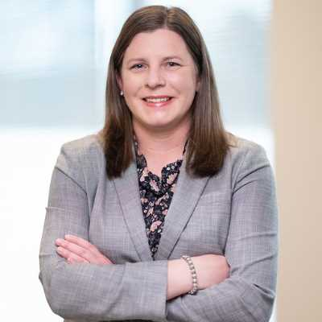
Financial Statement
38th Annual CSD Pool Membership Meeting
Refer to 2024 CSD Pool Annual Report Handout
Respond to Member Questions
Motion to Approve 2024 CSD Pool Annual Report
Allison Slife / Auditor
CliftonLarsonAllen, LLP
csdpool.org

Slide 9
Preparing for Disruption:
Business Continuity Tools to Keep
Your District Running
Keynote Address
Kyle Brown, Sr. Risk Control Consultant
Colorado Special Districts Property and Liability Pool
csdpool.org

Slide 10

Training Objectives
38th Annual CSD Pool Membership Meeting
Define what a Business Continuity Plan is
Identify the need for special districts to have a business continuity plan
Discuss identifying risk and complete a business impact analysis
Framework for a business continuity plan
Example of a successful plan being used
Resources to hep your district
csdpool.org

Slide 11










It’s Not if, It’s When…
Storm Damage
Human Error
Theft
Fire
Potential Threats to Continuous Supply
Power Loss
Natural Disaster
Viral Outbreak
Cyber Attack
Mechanical Failure
Water Supply Interruption
csdpool.org

Slide 12
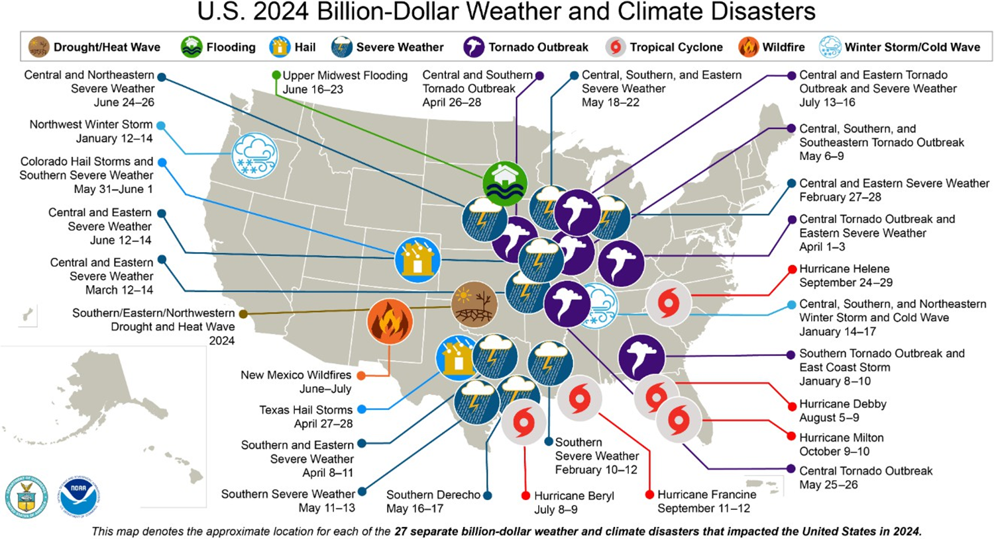
csdpool.org

Slide 13

Impact of Business Interruption
38th Annual CSD Pool Membership Meeting
Delayed or impacted services
Financial loss
Damage reputation-oops
Legal and regulatory consequences
Employee moral and retainment
Lasting impacts
csdpool.org

Slide 14
What is a Business Continuity Plan?
38th Annual CSD Pool Membership Meeting
NFPA 1660
  An ongoing process to ensure that the necessary steps are taken to identify the impact of potential losses and maintain viable recovery strategies, recovery plans, and continuity of services.
BCI/DRJ
  The process of developing prior arrangements and procedures that enable an organization to respond to an event in such a manner that critical business functions can continue within planned levels of disruption.
ISO 22301
  The capability of an organization to continue delivery of products within acceptable time frames at predefined capacity during disruption.
csdpool.org

Slide 15





Summary
38th Annual CSD Pool Membership Meeting
Assess Risk
Analyze Impacts
Create Recovery Plans
Continue Services
Protect Your District
csdpool.org

Slide 16

How Do I Start?
38th Annual CSD Pool Membership Meeting
A good place to begin is with asking yourself the following questions:
  What are my risks?
  What is the impact of those risks?
csdpool.org

Slide 17
Assessing Risk
Sample Risk Analysis Table
Severity
Catastrophic: 4
Critical: 3
Moderate: 2
Marginal: 1
High - 20
High - 15
High - 10
Medium - 5
Frequent: 5
Probable: 4
High - 16
High - 12
Serious - 8
Medium -4
Think back to some risks that threaten your operations, then assess your priorities.
High - 12
Serious - 9
Medium - 6
Low - 3
Probability
Occasional: 3
Serious - 8
Medium - 6
Medium - 4
Low - 2
Remote: 2
Medium - 4
Low - 3
Low - 2
Low - 1
Improbable: 1
csdpool.org

Slide 18
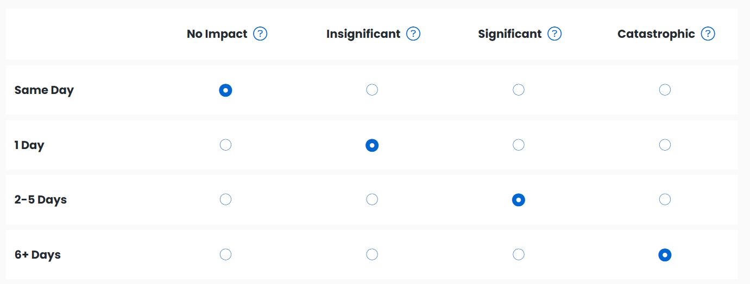
Impact Analysis
Explore the potential effects of various disruptions on your operations.
By assessing both the operational and financial implications, you’ll gain a clear understanding of where vulnerabilities are and which areas demand the most immediate attention.
csdpool.org

Slide 19
Other Considerations
38th Annual CSD Pool Membership Meeting
Recovery Time Objective (RTO)
Critical Dates
Process Dependencies
Continuity Strategies
Responsible Roles
Vendors
csdpool.org

Slide 20
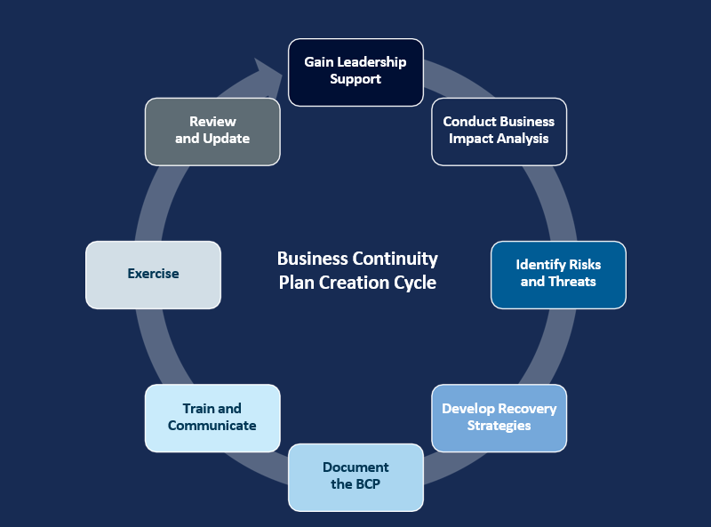
Business Continuity Framework
csdpool.org

Slide 21
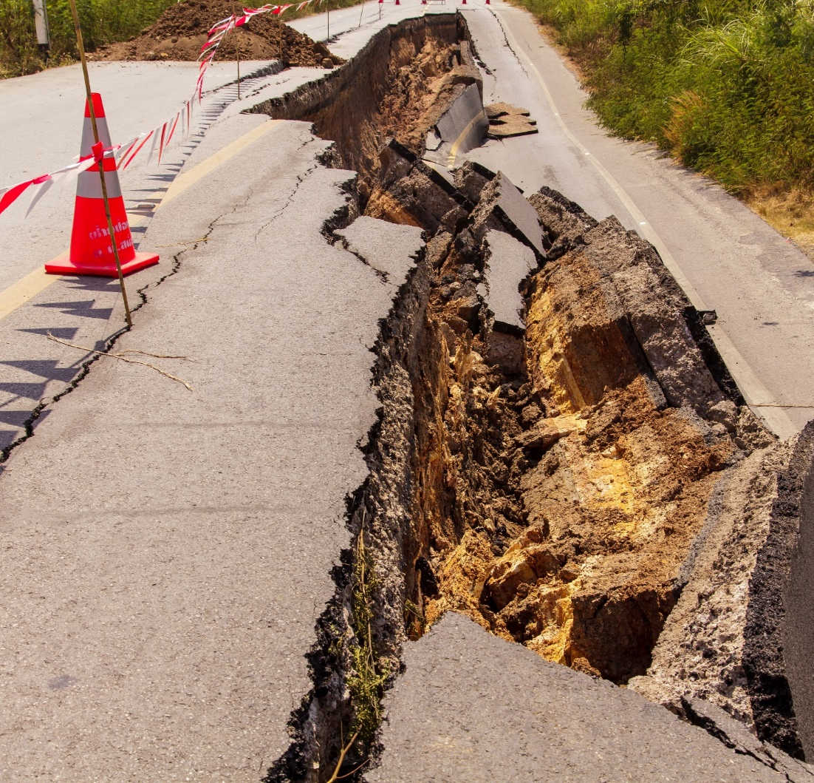
Example
38th Annual CSD Pool Membership Meeting
What is Our Entity Type?
  Fire and EMS Services
  Water & Sanitation
  Health Services
What is Our Disturbance?
  Natural Disaster
  Cyber Attack
  Theft
csdpool.org

Slide 22



Resources
38th Annual CSD Pool Membership Meeting
csdpool.org

Slide 23

Questions?
csdpool.org

Slide 24
Mid-Year Review & Insurance Market Update
38th Annual CSD Pool Membership Meeting
2025 YTD – Approx. 2,335 members and Gross Contribution $56 MM (16% increase)
Positive YTD Net Income of $2.5MM – Favorable Property & Liability losses with positive Workers’ Compensation results due to fewer Indemnity claims
  Fewer high dollar indemnity claims contributing to better WC performance
  Continued rate stabilization favors members with limited rate increases per Board rate stabilization policy
  Both programs returning to positive performance
Financial Strength
  Financial ratios available; strain on financial ratios moderated due to achieving rates more equitable
  Demotech Rating of the Pool continues as “AAA Unsurpassed”
csdpool.org

Slide 25
Mid-Year Review & Insurance Market Update (Cont.)
38th Annual CSD Pool Membership Meeting
Insurance market update shows property, liability, and cyber mixed, and more moderate price increases across most lines
Competition lacks the Risk Management programs and services the Pool offers
The CSD Pool is YOUR RISK MANAGEMENT PARTNER, bringing you the resources you need to ensure your fiduciary responsibility to protect district employees and assets is achieved
Questions?
csdpool.org

Slide 26
Renewal Process
38th Annual CSD Pool Membership Meeting
Renewal invitations for the Property & Liability (P&L) will be emailed this month. You will receive general information on rates, coverage changes, and a link to the CSD Pool website.
We ask all districts to complete their renewal updates online by end of day, October 31.
We will close the renewal website Friday, November 1. Districts that haven’t submitted their updates before this deadline will receive a 10% surcharge against their contribution with coverage then being automatically renewed.
csdpool.org

Slide 27
Renewal Process (Cont.)
38th Annual CSD Pool Membership Meeting
We review renewal submissions shortly after they are submitted. If any additional information or documents are needed, we’ll send an email with that request. We will begin issuing renewal documents Monday, October 6 and they will be processed in the order the complete submission was received. The sooner your updates are submitted to the CSD Pool, the sooner we can get your 2026 coverage documents to you!
Workers’ Compensation and Property & Liability renewals are processed and issued separately.
Remember, SDA Membership is required for you to be a member of the CSD Pool.
Questions?
csdpool.org

Slide 28
Property Renewal
38th Annual CSD Pool Membership Meeting
Annually, an evaluation is performed to determine what areas, if any, need to be changed for the next program year. The program can be left as written or there can be rate adjustments and/or increased deductibles.
Rate increases are needed again in 2026 to build surplus; in other words, build savings to have sufficient funds to pay future claims. Depending on the experience of each district type, rate increases will be:
  The CSD Pool implemented a hail surcharge under Property and Auto Physical Damage after the large 2018 hail losses. Rather than adding a large surcharge, it was decided to add incremental increases over a 10-year period to achieve rate stabilization and help avoid rate spikes when bad weather occurs. Still within that incremental period, we will increase the hail surcharge by another 7% in the hail prone counties.
Property: Ranging from 3% to 6% | Auto Physical Damage (APD): Ranging from 5% to 8%
Equipment Breakdown: Ranging from 1% to 4% | Crime: All district types will see a 2% increase
csdpool.org

Slide 29
Property Renewal (Cont.)
38th Annual CSD Pool Membership Meeting
The Wind/Hail Deductible endorsement will continue to apply. For districts that have a total value of real property and outdoor property below $25M, it increases the deductible to 2% of the covered damaged property and applicable business income at the time loss occurs, subject to a $5,000 minimum and $50,000 maximum per occurrence, unless a higher deductible is scheduled at the damaged location. For districts having total values excess of $25M, the terms are the same except the maximum per occurrence deductible is $75,000, unless a higher deductible is scheduled at the damaged location.
Alternatively, for an additional contribution, a deductible buyback endorsement is available which will reduce the Wind/Hail deductible to $5,000 per occurrence. The endorsement is available for purchase until May 1 annually.
The flood rate for properties located in high-risk Zone A will increase by 5%.
csdpool.org

Slide 30
Property Renewal (Cont.)
38th Annual CSD Pool Membership Meeting
  Building values will trend up between 2% and 3% based on the construction type while contents and inland marine scheduled items will increase by 4%.
  Automobile values will not be trended down this year for depreciation because studies have shown that tariffs in the auto industry are increasing the cost of a new car which then increases the demand for used cars (increasing the cost). In addition, the cost of auto parts such as engines, electronics, body parts, aluminum and steel are driving up repair and maintenance costs. Note, that this only applies to vehicles valued at Actual Cash Value. For those valued at Replacement Cost (which includes emergency vehicles), we encourage members to review and update the vehicle value to ensure it is sufficient to replace the vehicle in the event of a total loss due to these increasing costs.
    Additional rate adjustments or increased deductibles are possible for some individual members based on their own experience rating (losses compared to contributions).
csdpool.org

Slide 31
Property Renewal (Cont.)
38th Annual CSD Pool Membership Meeting
Members who do not participate or are not active in the SambaSafety driver monitoring program, will receive a 5% surcharge on their Auto Physical Damage contribution. We consider a member to be active when they have logged into the system at least annually to review and update employee list and driver information.
Coverage Form Changes:
  The Property and Auto Physical Damage Coverage documents will have very minor updates for 2026, all to correct sequencing and typographical errors. No change to coverage will occur.
  Questions?
csdpool.org

Slide 32
Liability Renewal
38th Annual CSD Pool Membership Meeting
As previously mentioned, an evaluation is performed to determine what areas, if any, need to be changed for the next program year. The program can be left as written or there can be rate adjustments and/or increased deductibles.
Rate increases are needed again in 2026 to build surplus. Depending on the experience of each district type, rate increases will be:
  Members who don’t participate or are not active in the SambaSafety driver monitoring program will receive a 5% surcharge on their Automobile Liability contribution. A member is active when they have logged into the system at least annually to review and update employee list and driver information.
General Liability, ranging from 3% to 5% | Automobile Liability, Ranging from 3% to 6%
Public Officials Liability, ranging from 3% to 5% | No Fault Water/Sewer, Ranging from 0% to 5%
csdpool.org

Slide 33
Liability Renewal (Cont.)
38th Annual CSD Pool Membership Meeting
  The rate for Volunteer Accident coverage will increase by 50%. This increase may sound like a lot, however based on the current hours reported, not one district will pay more than $350 in additional annual contribution due to this increase. We anticipate this will be the last year of such a high rate increase on this coverage line.
  Additional rate adjustments or increased deductibles are possible for some individual members based on their own experience rating (losses compared to contributions).
Questions?
csdpool.org

Slide 34
Workers’ Compensation Renewal
38th Annual CSD Pool Membership Meeting
Renewal Process and Updates
  Board Member Only (BMO) Districts
    No contribution increase: BMO’s remain at $450, less applicable direct discount for 2026
    BMs need to continue to report all duties being performed in addition to any other BM Administrative duties
    Obtain Certificates of Insurance and Independent Contractor Status Forms from all contractors
    BMO renewal packets were emailed to members or brokers in mid-August. Changes must be received by October 17. Payments due January 1. Intent-to-Cancel Notices issued by the end of January for non-payment, as applicable
    A payment reminder was put in mail this week
    We will continue to send payment reminders via email later this year
  All Other Districts
    5% - 10% increase on base rates. Review your payroll changes as you budget for 2026. Contribution is rated on payroll.
    Renewal invites were emailed on August 27. Please complete updates by October 17
    A renewal reminder was mailed on September 9
    Make sure Payroll Schedule is updated in its entirety based on your 2026 budget
    Non-responders will receive a 10% increase on payroll starting December 1 thus generating an automatic renewal
    Payments due January 9, 2026 to take advantage of our Early Pay Discount
    Intent-to-Cancel Notices will be issued by the end of January in the event of non-payment
csdpool.org

Slide 35
Final Business
38th Annual CSD Pool Membership Meeting
Any other business or questions from the membership?
We have most of our Claim Adjusters from Sedgwick here; they will be at the Pool’s booth; so, please feel free to take the opportunity to meet with those you have worked with.
Move to adjourn meeting.
csdpool.org

Slide 36
Thank You for Attending!
Email questions to info@csdpool.org
Prize Drawings Up Next!
You must be present to win.
Questions? Come see us at our booth!
csdpool.org

